Slide 1
Philippines Delivery Center DevOps
Webservers: Apache Tomcat

Slide 2
Agenda
Overview of webservers
Installation and Set-up
Deployment of WAR file

Slide 3
Overview of Webservers
What are Webservers?
A web server is a computer hosting one or more websites. "Hosting" means that all the webpages and their supporting files are available on that computer. The web server will send any webpage from the website it is hosting to any user's browser, per user request.

Slide 4
"Web server" can refer to hardware or software, or both of them working together.
On the hardware side, a web server is a computer that stores a website's component files (e.g. HTML documents, images, CSS stylesheets, and JavaScript files) and delivers them to the end-user's device. It is connected to the Internet and can be accessed through a domain name.
On the software side, a web server includes several parts that control how web users access hosted files, at minimum an HTTP server. An HTTP server is a piece of software that understands URLs (web addresses) and HTTP (the protocol your browser uses to view webpages).

Slide 5
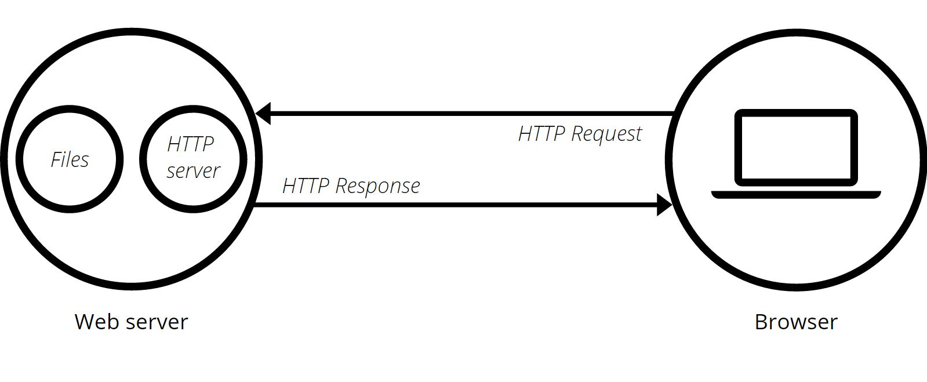
At the most basic level, whenever a browser needs a file hosted on a web server, the browser requests the file via HTTP. When the request reaches the correct web server (hardware), the HTTP server(software) sends the requested document back, also through HTTP.

Slide 6
Types of Webservers
Static web server, or stack, consists of a computer (hardware) with an HTTP server (software). We call it "static" because the server sends its hosted files "as-is" to your browser.
Dynamic web server consists of a static web server plus extra software, most commonly an application server and a database. We call it "dynamic" because the application server updates the hosted files before sending them to your browser via the HTTP server.

Slide 7
Hosting Files
A web server first has to store the website's files, namely all HTML documents and their related assets, including images, CSS stylesheets, JavaScript files, fonts, and videos.
Technically, you could host all those files on your own computer, but it's far more convenient to store them all on a dedicated web server that
is always up and running
is always connected to the Internet
has the same IP address all the time (not all ISPs provide a fixed IP address for home lines)
is maintained by a third-party provider

Slide 8

Apache Tomcat
The Apache Tomcat® software is an open source implementation of the Java Servlet, JavaServer Pages, Java Expression Language and Java WebSocket technologies. The Java Servlet, JavaServer Pages, Java Expression Language and Java WebSocket specifications are developed under the Java Community Process.

Slide 9
Setup
Install Tomcat
Edit Environment Properties
JAVAHOME: C:\Program Files\Java\jdk1.7.0_79\bin
CATALINAHOME:
Open command prompt
Run : startup.exe

Slide 10
Deployment of WAR file
Go to /Tomcat/Webapps
Copy and paste WAR file
Restart Tomcat

Slide 11
Sources:
https://developer.mozilla.org/en-US/Learn/Common_questions/What_is_a_web_server
https://developer.mozilla.org/en-US/Learn/Common_questions/Pages_sites_servers_and_search_engines
http://tomcat.apache.org/index.html

